Slide 1
Transaction Costs, Risk Aversion, and the Choice of Contractual Arrangements
Written by Steven N.S. Cheung 张五常
Journal of Law and Economics
1969

Slide 2
Literature Review
Prevailing impression on Sharecropping at that time:
Inefficient resource allocation (Schickele, 1941; Heady, 1947)
Tax-equivalent approach (Smith 1937; Marshall 1956)
Different opinion: Bray (1963) found that agricultural yields under share leases were impressive in the U.S.
New Theory: Cheung (1968)

Slide 3
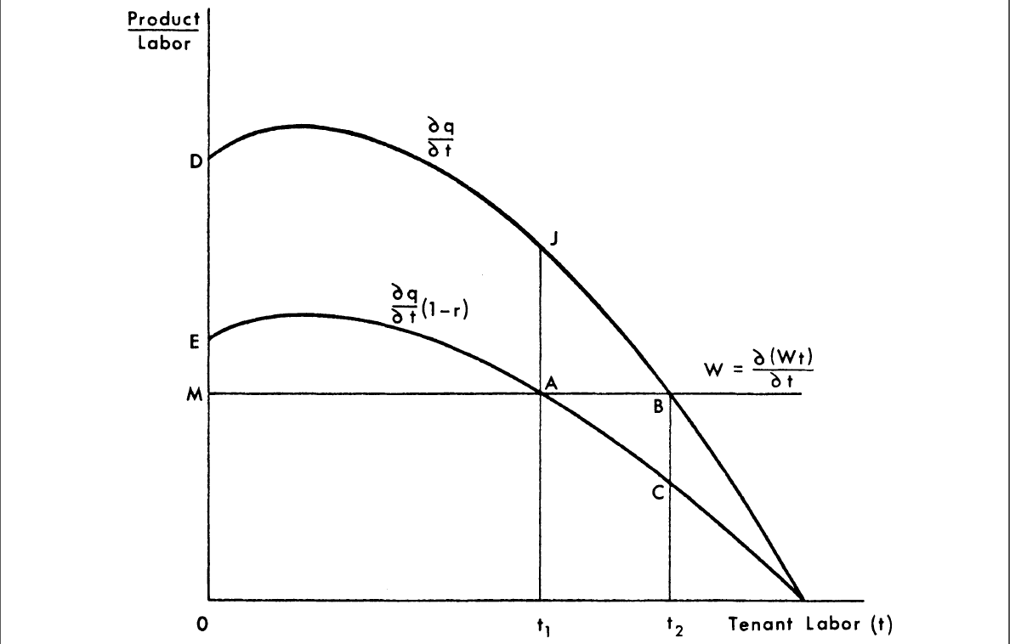

Slide 4
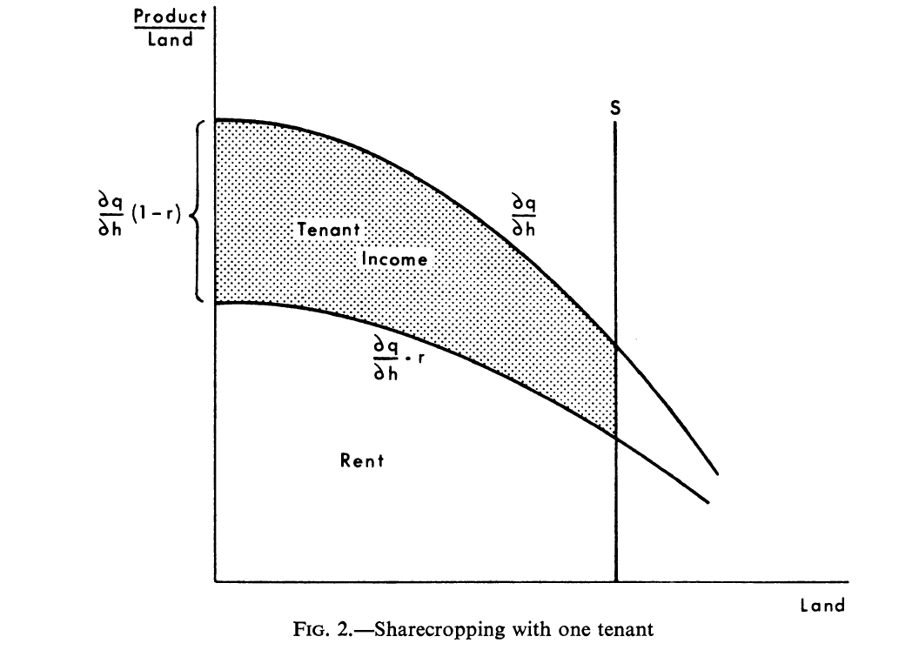

Slide 5
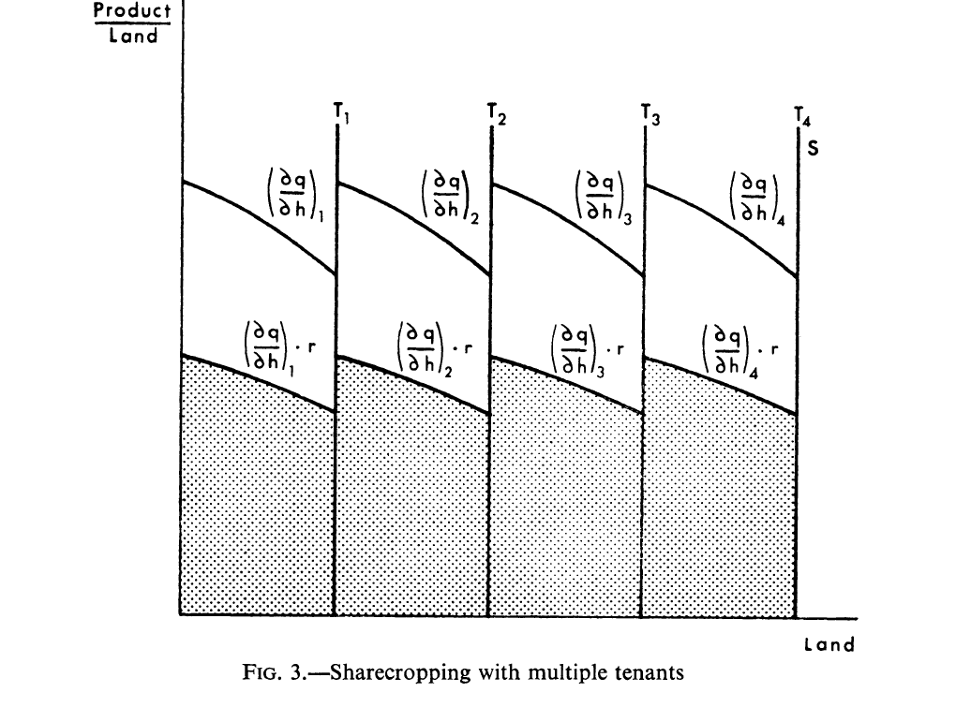

Slide 6
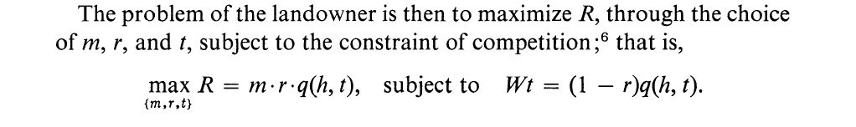
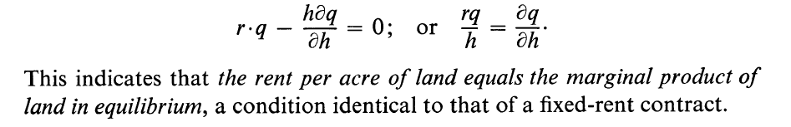
h: amount of land per farm; m: the number of farms; r: rental percentage; t: the amount of tenant labor per farm; W: market wage rate of the tenant labor; R: landowner’s total rent

Slide 7
Back on Topic
Economic efficiency is the same in different land tenure arrangements
Key Assumption: Transaction cost is zero
Fundamental Hypothesis:
1. Maximize the gain from risk dispersion
2. Constraint of transaction costs
Methodology: Logical Reasoning and Observation

Slide 8
Facts
Taiwan and Southeast Asia: share contracts were more frequent than fixed rents before the agrarian reforms
China: Fixed rents dominated in 1930s
Japan: Fixed rents predominated; wage contract is infrequent
What determines the choice of contracts?

Slide 9
Reasoning Process
Share contract: highest transaction cost
Fixed rent and wage contract: highest risk for one party
Should consider both the differences in transaction costs and the postulate of risk aversion (variance in product amount)
Share contract: risk dispersion leads to higher utility, but higher transaction cost also reduces the utility

Slide 10
Evidence: Observation
1. A third party (insurance company) will insure the amount of crop yield: French metayage (sharecropping) and fermiers.
2. In China, share tenancy is more frequent in the wheat region than in the rice region: Wheat production has much higher variances than Rice.
3. Share rent is generally slightly higher than fixed rent: a return for risk bearing to the landowner.
In summary: risk aversion and the minimization of transaction costs should be considered together.
Some key factors:
1. Physical attributes of crops and types of climate
2. Legal arrangement like compulsory or subsidized crop insurance

Slide 11
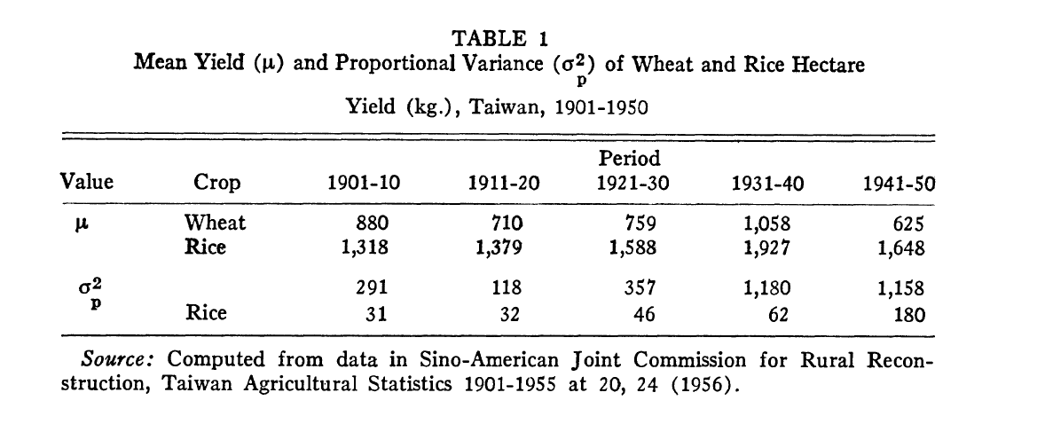

Slide 12
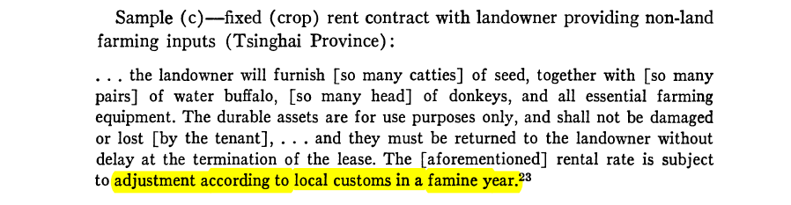
Market Arrangement
“Escape clause” for the tenant.
One feature in fixed rent contracts in China: provision for rental reduction according to “local customs” in a “famine” year

Slide 13
Forms of Contract
Insurance
Escape Clause
Sharecropping
Risk Sharing
Fixed Rent Contract
Wage Contract
All Risk on tenants
All Risk on landowners

Slide 14
Market Arrangement
Duration of lease contracts
Quick Facts: In 1934, 29% of contracts were unspecified (usually terminable after every harvest); 25% annual leases, 27% 3 to 10 years, 8% from 10 to 20 years, and 11% perpetual leases.
Tenancy dismissal was not high (7.5% in 1937).
Traditionally, economists believed lease durations of less than 10 years is inefficient.
Reasons: 1. Insecurity on the tenant; 2. Discourages investment on land
Criticism: 1. Insecurity can be stimulus 2. yields on tenant farm are not lower than on owner farms.

Slide 15
Market Arrangement
Again we are in the world with transaction costs; The goal of different durations in contracts is to minimize transaction costs.
Why relatively long lease duration:
Reduce the cost of transferring tenant assets attached to land: Water buffalo; water irrigation system.
Why relatively short lease duration:
Reduce the costs of enforcing the contracted terms and of renegotiating these terms
a. lack information on each party’s reliability: short term lease can facilitate tenancy dismissal. May not be the case in China as lease dismissal caused by rental disputes was low.
b. Short-term leases may be a device to facilitate contractual renegotiation: reallocation of resources vs. revision of income distribution

Slide 16
Conclusion
Different contractual arrangements do not imply different efficiencies of resource allocation as long as property rights are exclusive and transferable.
Different contractual arrangements are caused by different transaction costs and risks
Other things the author did not consider:
1. All risky choices instead of contractual choice alone.
2. Develop a model of general equilibrium including transaction costs
3. Legal enforcement can change transaction costs

Slide 17
Comments
Research approach based on anecdotal evidence
Revisit Shaban (1987).
“Monitoring approach” to sharecropping: landlords stipulate the intensity of labor per unit area, and they have a sufficiently inexpensive and effective monitoring ability to ensure that their stipulation is indeed fulfilled.
It provided different results in the productivity among different contractual arrangements.
Risk reduction should be a kind of product? Only consider transaction cost in his model?
Contract arrangements in Africa. (Matoussi and Nugent).

Slide 18
References:
Bray, James 0. " Farm Tenancy and Productivity in Agriculture: The Case of the United States," Food Res. Inst. Studies, Vol. IV, No. 1 (1963).
Heady, Earl. "Economics of Farm Leasing Systems," J. Farm Econ. (August, 1947).
Marshall, Alfred. Principles of Economics. London: Macmillan Co., 1956
Radwan Shaban 1987 Testing between Competing Models of Sharecropping JPE and reprinted Ch 4 in BUR
Schickele, Rainer. "Effect of Tenure Systems on Agricultural Efficiency," J. Farm Econ. (February, 1941).
Smith, Adam. Wealth of Nations. New York: Modern Library, 1937.
Steven N. S. Cheung, Private Property Rights and Sharecropping, 76 Journal of Political Economy. 1107 (1968).

